Slide 1
Low Power System Design (PVL 207)

Slide 2
Minimizing switched capacitance
Switched capacitance minimization techniques:
Hardware software trade-off
Bus encoding
Clock gating
Gated FSM
State encoding
Logic styles
Use of number systems
Architecture level optimizations

Slide 3
Clock Gating
A major component of processor power is the clock power (50% of the total power)
One of the most successful and commonly used low power technique is clock gating.
It is based on the observation that a large number of transitions are unnecessary
Such transitions can be suppressed without affecting functionality.

Slide 4
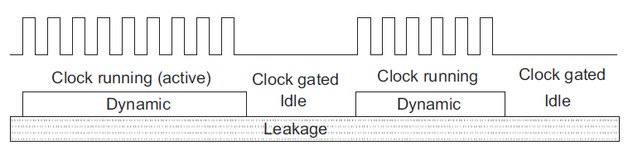
Clock Gating
Usage of a functional element is highly dependent on the application in hand.
There are opportunities to shut off circuits that are not in use.
Dynamically preventing the clock from propagating to some parts of the circuit under certain conditions.
Power reduction using clock gating

Slide 5
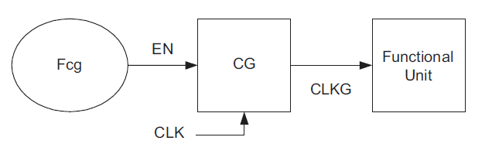
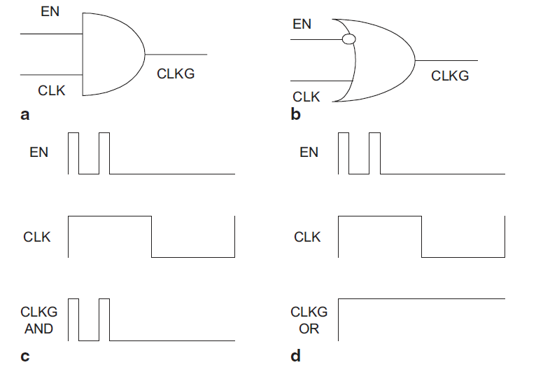
Clock gating principle
Clock Gating Mechanism
As long as the enable signal, stabilizes before the high to low transition of the clock the glitch generated by the Fcg cannot propagated through the OR gate.
A clock gating using AND gate b) Clock gating using OR gate c) Glitch propagation
through AND Gate d) Glitch propagation through OR gate

Slide 6
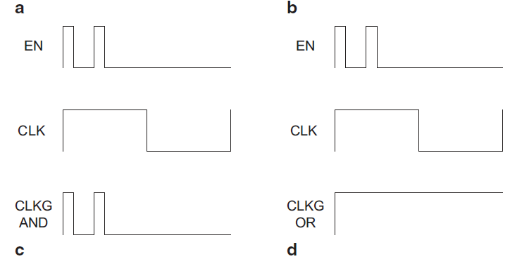
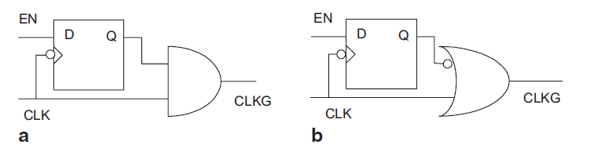
Improved clock gating circuit
A better circuit uses a level sensitive, low active latch and a AND gate to prevent the propagation of the glitches generated by the fcg circuit.
a Clock gating using a level-sensitive, low-active latch along with an AND gate and
b clock gating using a level-sensitive, low-active latch along with an OR gate.

Slide 7
Clock Gating Granularity
Granularity of the circuit block at which the clock gating is applied greatly affects the power saving that can be achieved.
Gating larger blocks results in larger power savings but allows fewer number of OFF cycles.
Three levels of Granularity:
Module level clock gating
Register level clock gating
Cell-level clock gating

Slide 8
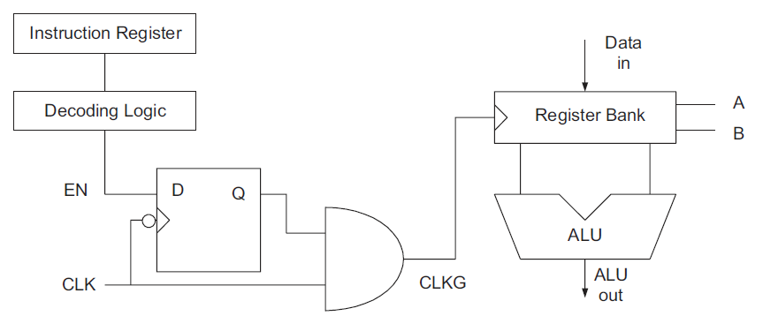
Module level clock gating
The register bank is clock gated to prevent unnecessary loading of operands to the ALU when load store Instruction is executed.
Memory bank can be clock gated in case of ALU operations in a similar manner

Slide 9
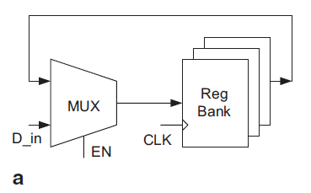
Register Level Clock Gating
The clock to a single register or a set of registers is gated.
A synchronous load enabled register bank typically implemented using clocked D flip flop and a recirculating multiplexer.
The register gets the clock in all the cycles even when no data is loaded.
Gating condition for registers may be obtained through symbolic analysis
of the combinational circuit that feeds it.

Slide 10
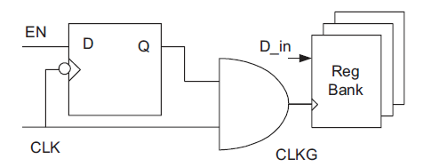
Register level Clock Gating
The register does not get the clock in the cycles when no new data is loaded.
Elimination of the MUX saves power.
The penalty of the clock gating circuit can be amortized over a large number of registers.
The power saving per clock gate is much less, but there is much more scope than module level gating.

Slide 11
Challenges in Massively Gated Clocks
Provides many more opportunities and it lends itself to automated insertion and can result in massively clock gated designs.
Massively clock gated design issues:
Clock Latency
Effect of clock skew
Clock tree synthesis
Clock gating leads to additional complexity to synthesis and analysis tools making testing and verification difficult.

Slide 12
Clock Latency
When a single clock gate drives a large number of registers, it may not have enough drive strength, requiring clock tree at the output.
The enable signal must be ready before the clock arrives at the gating logic.
This must be addressed during synthesis.
Clock latency at the clock gate must be smaller than that at the registers and the difference is the delay of the clock gate.
Either a worst case estimate of clock tree synthesis delay or restriction the fan out of the clock gates.

Slide 13
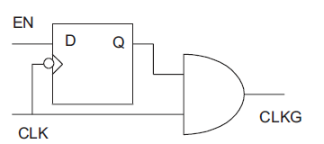
Effect of Clock Skew
Clock skew between the latch and
the AND gate may lead to
glitches at the gated clock output.
It is essential to ensure that glitches are not introduced, which may lead to circuit malfunction due to spurious loading of registers.
The clock skew between the latch and the AND gate should be less than the clock-to-output delay of the latch.
Relative placement of the latch and the AND gate imposes stringent constraint on the clock-tree synthesis tool.

Slide 14
Clock Gating in the clock tree
Clock tree amounts to a significant portion of the total dynamic power consumption.
It leads to tradeoff between the physical capacitance that is prevented from switching and the number of unnecessary transitions.
Disabling at higher up in the tree prevents larger capacitance from switching but the gating condition is rarely satisfied.
Having multiple gating points along a path may be beneficial.

Slide 15
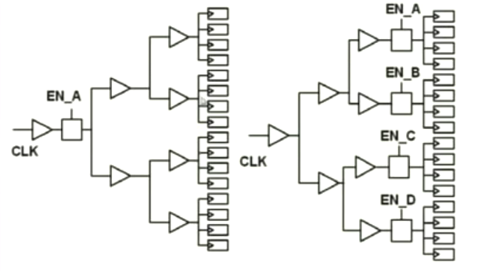
Gating clock close to the root
Clock gating close to the registers:
Optimized for clock skew

Slide 16
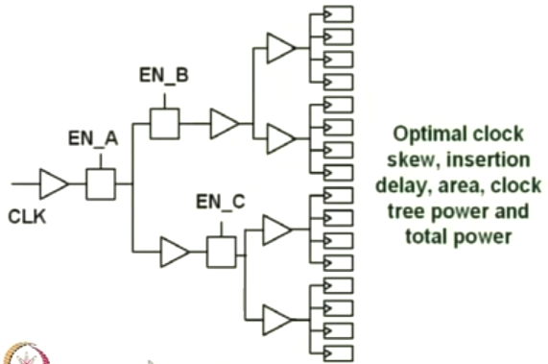
Clock Gating in the clock tree

Slide 17
Cell Level Clock Gating
Cell designer introduces cell level clock gating.
Example: A register bank is designed such that it receives clocks when new data needs to be loaded.
Memory bank can be clocked only during active access cycles.
It is simple without any design flow issue, but may not be efficient in terms of area and power.
There is area overhead and all registers are to be predesigned with clock gating.
Does not allow sharing of clock gating logic across many registers.
No reduction in switching in the capacitance of the clock gate in the register.

Slide 18
Conclusion
The combination of explicit clock gating cells and automated insertion makes clock gating a simple and reliable way of power reduction.
No change in the RTL is required.
Pokhrel implemented a 180 nm chip with and without clock gating [ Physical and silicon measures of low power clock gating success: an apple to Apple case study, SNUG 2007.]
20% reduction in area (due to removal of MUXs)
34% to 43% power savings (clock buffers after the clock gating cells)

Slide 19
References
Ajit Pal, “Low power VLSI Circuits and Systems” Springer, 2015.

